Slide 1
Masonry Tender Training Program
Your first step towards building your future

Slide 2
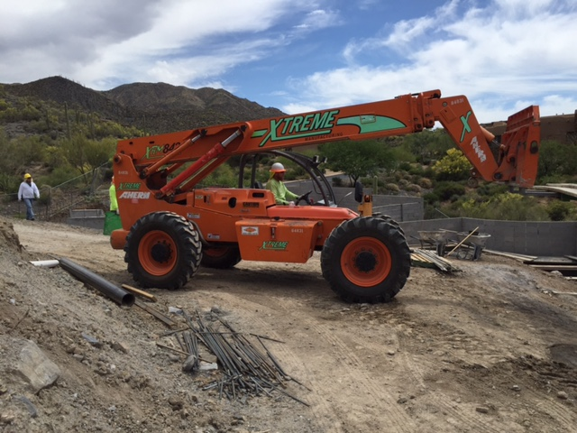
Agenda
Welcome & Introductions
Program Overview
Review of Program Policies & Procedures
Review of Training Schedule

Slide 3
Introductions
Name
Previous work experience

Slide 4
Masonry Tender Training Program Overview

Slide 5
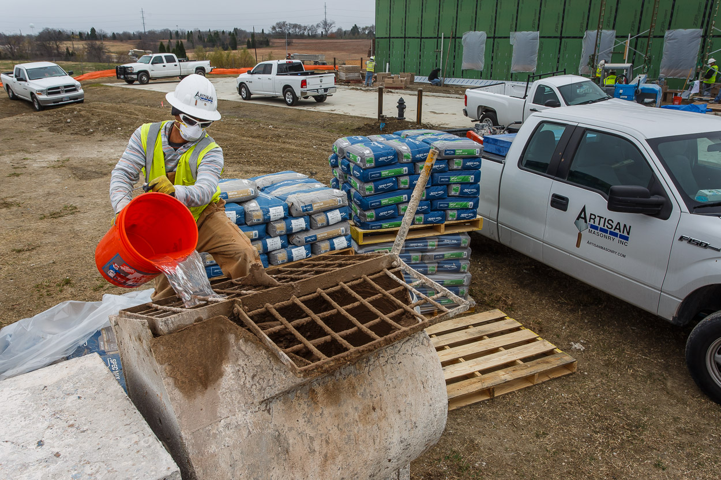
Program Purpose
Recruit new talent into our industry
Provide program participants with training in 4 of the most important skill areas needed to secure a job as a Tender.
Assist our members in filling open tender positions by matching program graduates with potential employers.
Provide follow up training to allow program graduates to build their skills & knowledge

Slide 6
Program Overview
Mason Tender
  Sets up work site so masons can work safely and efficiently
  Tends to the masons as they perform their work
  Cleans up when work is complete
Program will focus on 4 main skill areas:
  Jobsite Safety
  Mortar- mixing & tempering mortar
  Stocking masonry materials & accessories
  Erecting & dismantling scaffold

Slide 7
Program Overview
Program participants who successfully complete all 6 days and demonstrate mastery of the above skill areas will then have an opportunity to interview with companies who are looking to hire Tenders.
  Job placement is not guaranteed upon completion of the program.
  Starting hourly wage will be determined by hiring masonry contractor
  Program participants will not be paid for their time in the Masonry Tender Training Program.

Slide 8
Policies & Procedures
Must attend 6 days in order to complete the program.
Arrive on time & be prepared.
  Don’t forget your PPE
  Dressed in appropriate attire- jeans/work pants, work boots, long sleeve shirt.
Follow all safety procedures/requirements- SAFETY FIRST!
  Failure to follow all safety procedures will result in immediate termination from the program.
Stay HYDRATED!
  We are guests of «LOCATION».
  Review of «LOCATION» Guidelines
Ask questions.
  If you don’t understand, please ask your instructor questions.

Slide 9
Overview of This Week’s Schedule
Monday - CMU & Mortar, Setting up Mixing Station and Mason’s Workstation
Tuesday - Overview of Hand Tools, Power Tools, Stocking Masonry Materials
Wednesday - Scaffold
Thursday - Mixing Mortar, Building Scaffold, Stocking Masonry Materials, Cutting CMU
Friday - OSHA 10
Saturday - OSHA 10

Slide 10
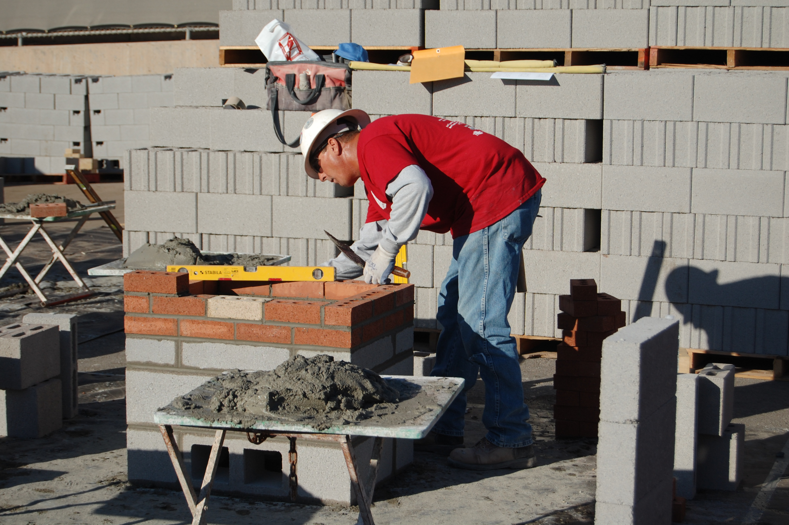
Life after the Program- What’s next?
  Monday, «MONTH» «DAY» report to masonry contractor’s office to complete new hire paperwork, drug tests etc.
Apply for the Masonry Apprenticeship Program to become a Journeyman Mason
  We recommend waiting at least 6 months to a year before applying
  Masonry Contractor must sponsor you into the program.
Apprentice
  Assists Tenders
  Assists foreman with layout and other specialized tasks
  Installs masonry along side Journeyman
Apprenticeship Program is a 3 year commitment
  Combination of classroom instruction & hands-on training
    Textbooks with quizzes & tests
    Graded Masonry Projects
    Final exams given each year

Slide 11
Masonry Career Paths
Superintendent
  Supervises multiple projects for the contractor
Estimator
  Prepares detailed bid proposals for the contractor
Contractor
  Company owner ultimately responsible for all aspects of the work
  Must be knowledgeable about all phases of the business

Slide 12
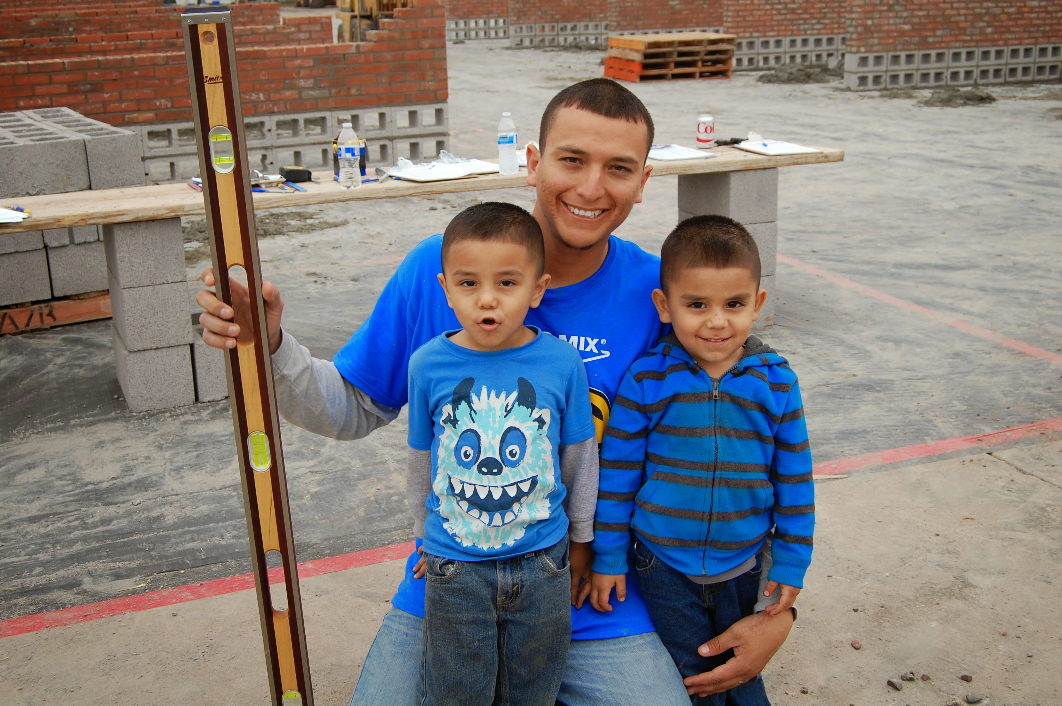
Are you ready to starting building your future?

