Slide 1
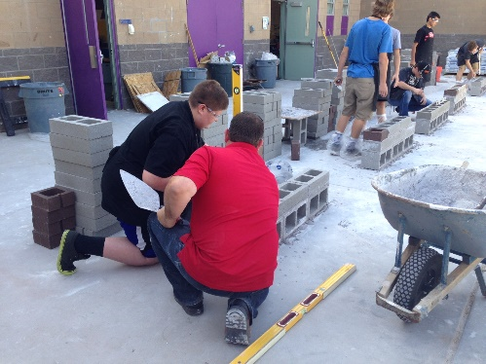
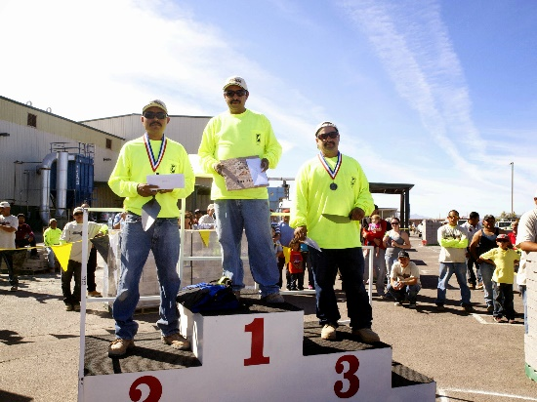

Masonry Tender Training Program

Slide 2
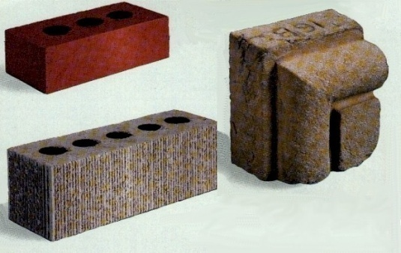
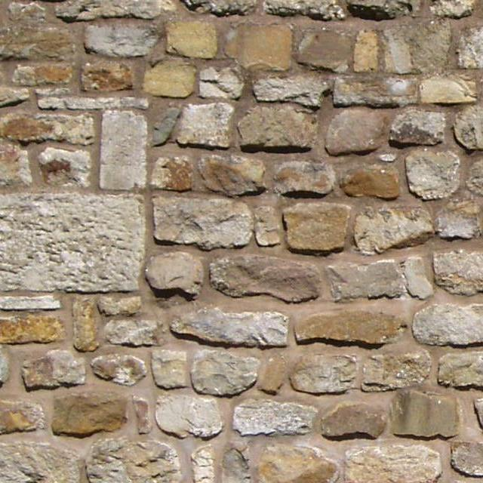
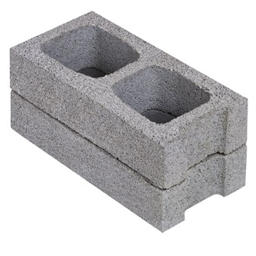
Masonry Materials

Slide 3
Evolution of Masonry Materials
Stone
Used in construction since the dawn of time
Cut to fit together like a jigsaw puzzle
Sun dried brick
First used around 4000 BC
Humanity’s oldest manufactured product
Extremely susceptible to weathering
Coated with mud to add durability
Chopped straw added to give brick greater strength

Slide 4
Evolution of Masonry Materials
Kiln-fired Brick
Produced a more weather resistant brick
Introduction of standardized size 8” x 2” x 16”
Installed using mortar
Installed in different positions and patterns for added beauty
Concrete Masonry Units
Introduced in 1850 by Joseph Gibbs
First block made in wood forms
In 1900 Harmon S. Palmer patented machine that made a monster unit 8” x 10” x 30”
Modern manufacturing facilities extremely efficient

Slide 5
Stone
Rubble and ashlar:
Dry and mortared stone walls
Retaining walls
Facing walls
Slope protection
Paving, patios, walkways
Fireplaces
Flagstone:
Paving and floors
Notes:
Explain that rubble is collected from fields or quarries and is irregular in size and shape, but it can be roughly squared with a brick hammer. Also explain that ashlar is stone that is cut at a quarry, and flagstone is usually quarried slate.

Slide 6
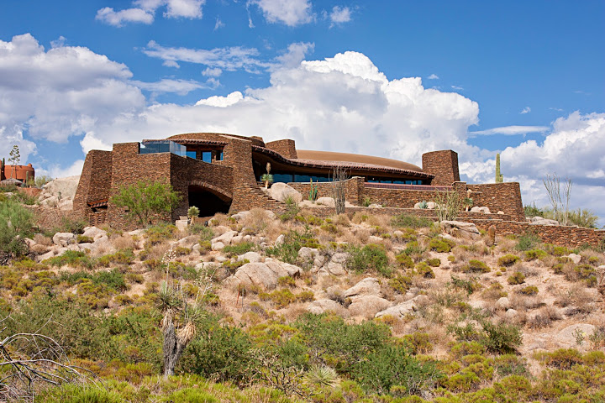

Slide 7
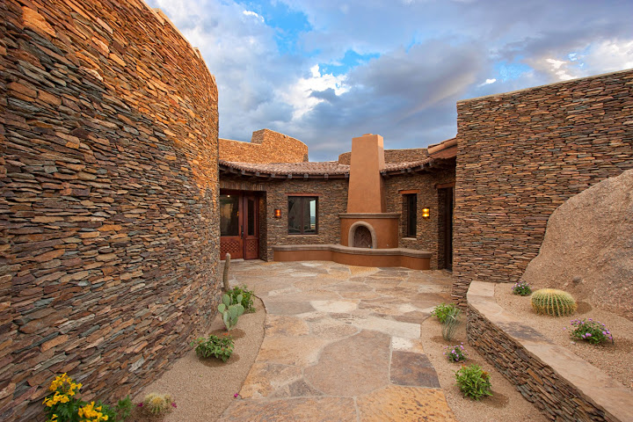

Slide 8
Clay Products
Brick (solid masonry units):
Classifications:
building
facing
hollow
paving ceramic glazed
thin veneer
sewer
manhole
Tile (hollow masonry units)
Architectural terra cotta units
Notes:
Explain that brick is also classified as being solid if no more than 25% of its surface is cored, meaning that the brick has holes extending through it to reduce weight, and that iIf the brick has no holes at all, it is called uncored brick.

Slide 9


Slide 10


Slide 11
Concrete Masonry Units
Classified by intended use, size, and appearance
ASTM International standards for masonry units:
Loadbearing and nonbearing concrete block
Concrete brick
Calcium silicate face brick
Pre-faced or prefinished facing units
Manholes and catch basin units

Slide 12
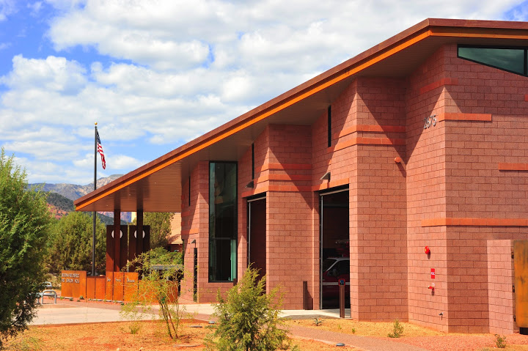

Slide 13
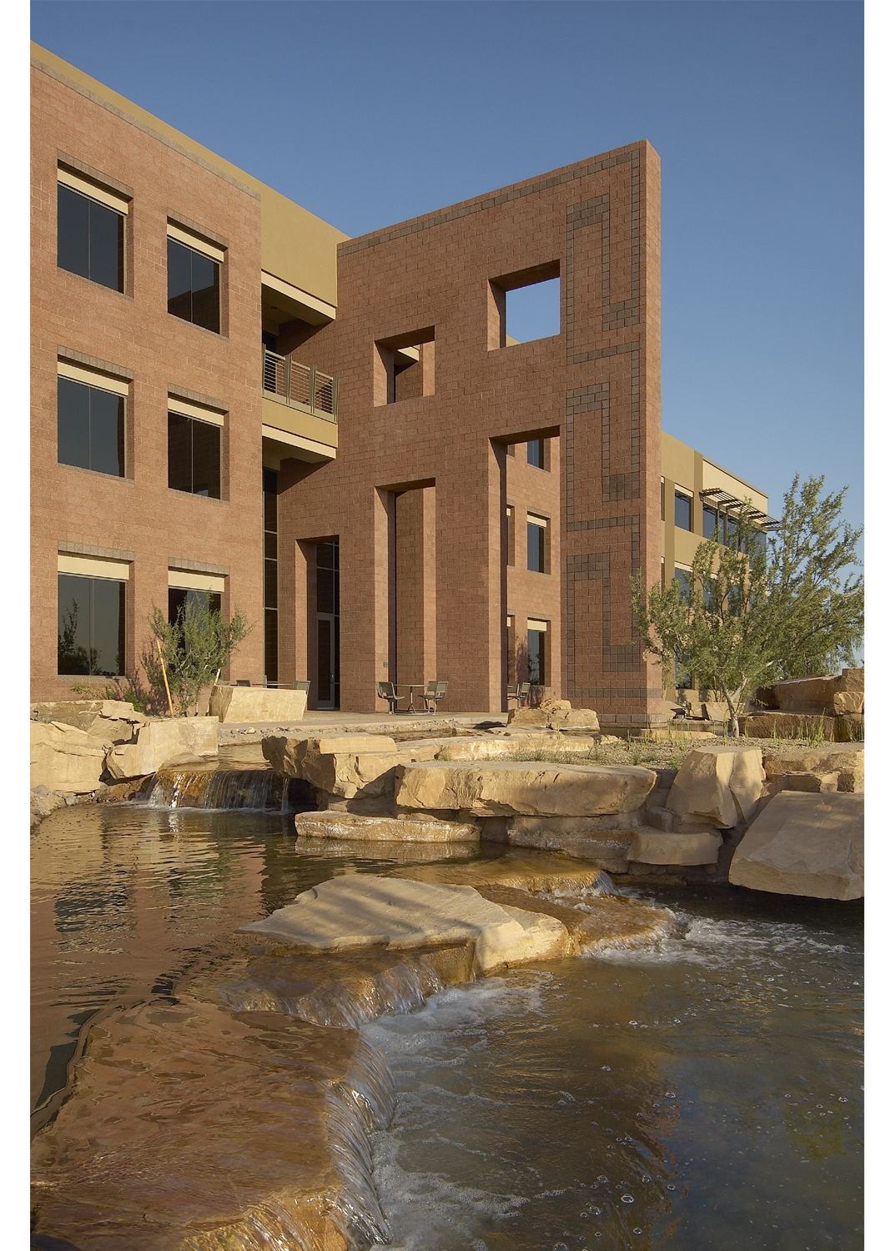

Slide 14
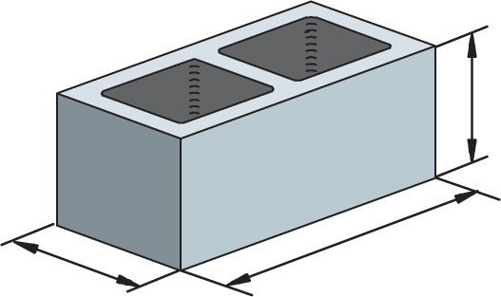
Concrete Masonry Units (CMU)
Typical actual dimensions:
Width x Height x Length
8 x 8 x 16
7 5⁄8”
15 5⁄8"
7 5⁄8"
Actual Unit
Dimensions
Notes:
Note that actual dimensions refer to the dimensions of the block itself, while nominal dimensions include the thickness of the mortar in the measurement. Also explain that aerated block is made with an admixture that generates gas bubbles inside the concrete to make the block lighter.

Slide 15


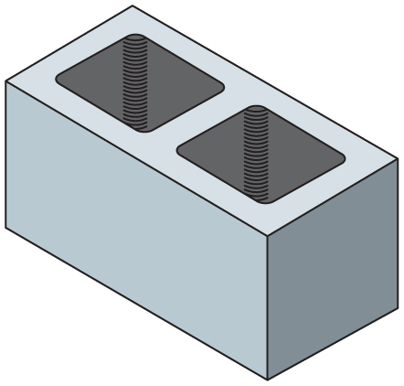
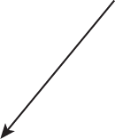
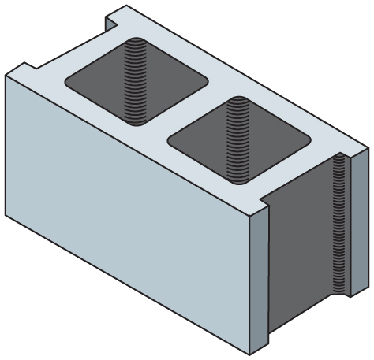


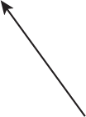
Parts of a CMU
Cross Web
Concave End
Cell or Core
Face Shell
Plain End
Ends or Ears

Slide 16
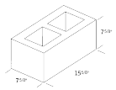
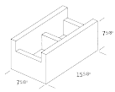


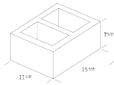


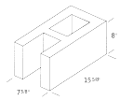
Common Shapes for CMU
8816 Stretcher
888 Half
8816 Bond Beam
8416 Stretcher
12816 Stretcher
4816 Stretcher
4816 Interlock
8816 A-block
Notes:
Discuss the purposes of the different features of the blocks.

Slide 17
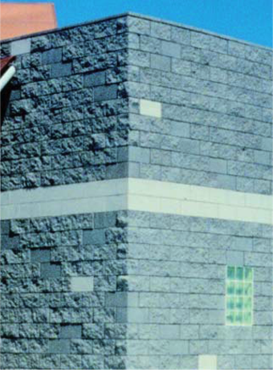
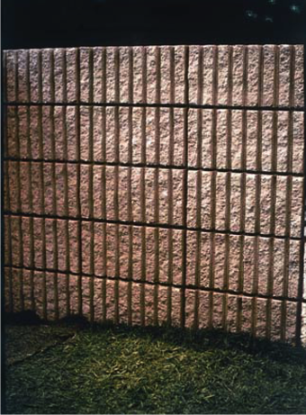
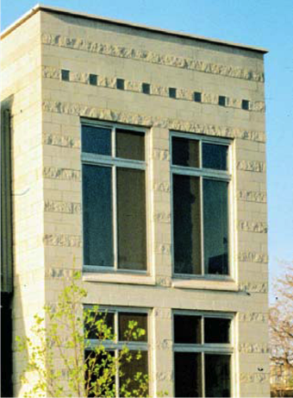
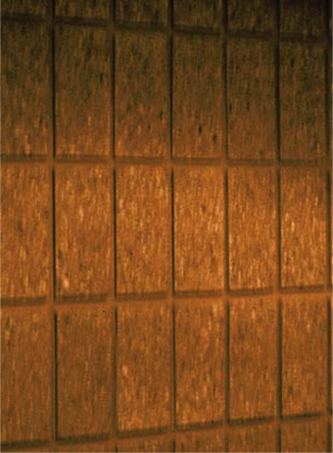
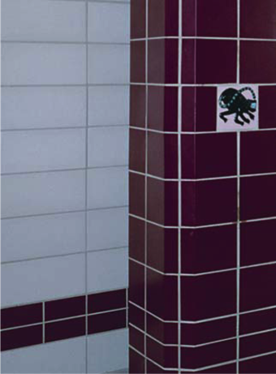
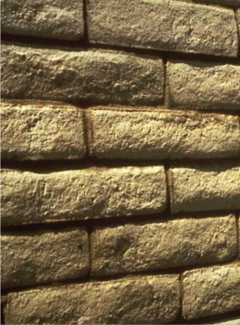
Architectural Block Finishes
Split Face and Glazed
Fluted Split Face
Split and Ground Face
Scored and Ground Face
Glazed
Slump Block
Notes:
Point out that surface finishes on architectural blocks make veneer unnecessary.

Slide 18
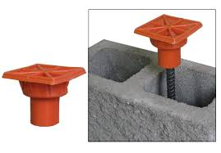
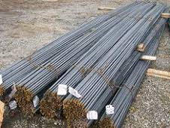
Reinforcing Steel (Rebar)
Placed vertically and horizontally in CMU
Notes:
Point out that anchors must be installed according to specifications because they affect the loadbearing of a wall.

Slide 19
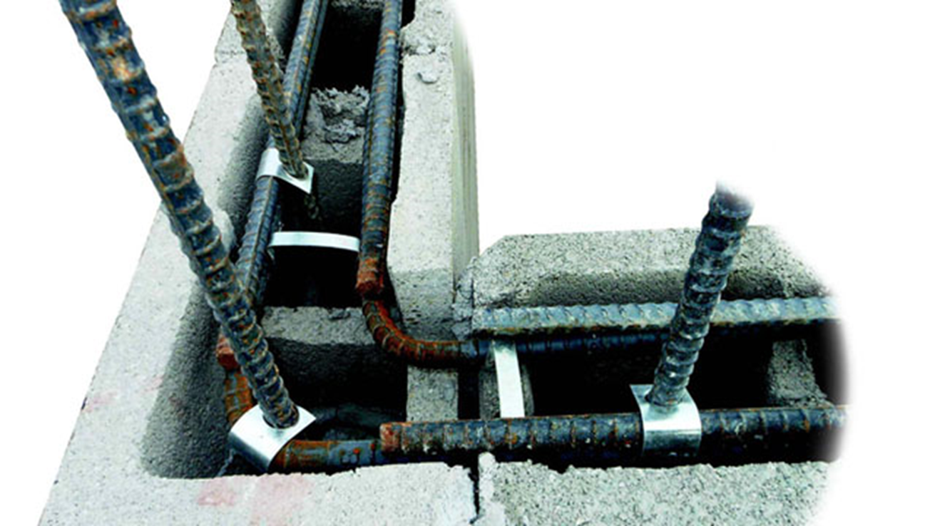

Slide 20
Structural Masonry Inspection
Main ribs
Bar size # (mm)
3 (10)
4 (13)
5 (16)
6 (19)
7 (22)
8 (25)
9 (29) 10 (32) 11 (36)
Letter for producing mill¹
H
H
Bar size #13⁴
13
13
S
Type steel (new billet)
S
Grade mark line²
Grade 40
Grade 60
Notes:
Current designation of reinforcing steel is by ‘soft metric’, that is, the size of reinforcement did not change from the inch designation (#3, #4, #5…..) and the metric designation (#10, #13, #16……..) correlates to the inch size designation.

Slide 21
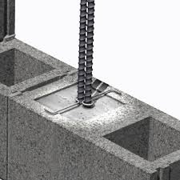
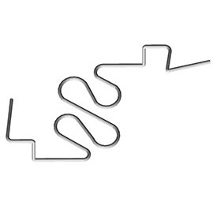
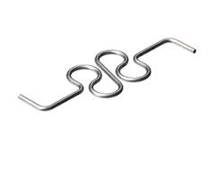
Rebar Positioners
Hold rebar in position for grout placement
Notes:
Point out that anchors must be installed according to specifications because they affect the loadbearing of a wall.

Slide 22
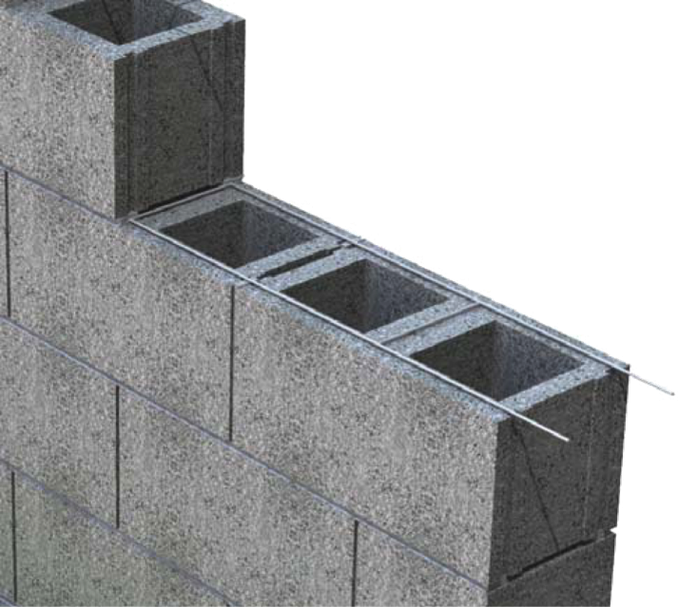
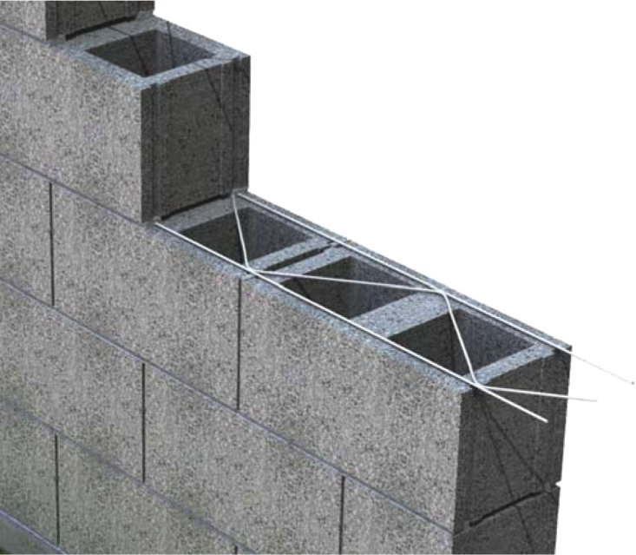
Horizontal Joint Reinforcement
Used in horizontal joints every second or third course, as specified
Ladder (Rectangular)
Cross Bracing
Truss (Triangular)
Cross Bracing
Notes:
Trainees should be able to explain that horizontal joint reinforcements are made of two 10-foot lengths of steel bars welded together by rectangular or triangular cross bracing.

Slide 23
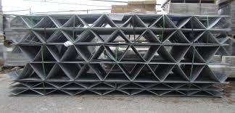
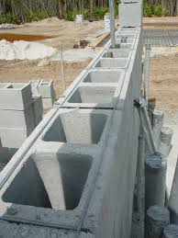
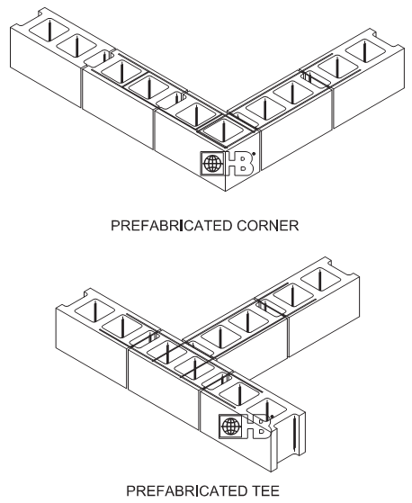

Slide 24
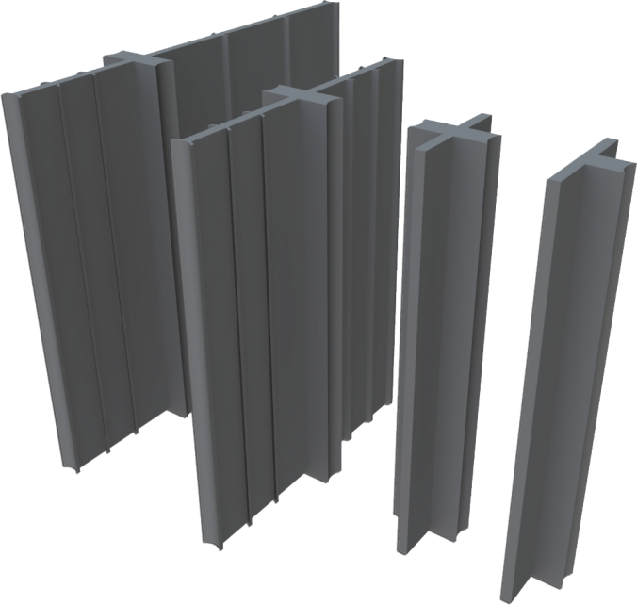
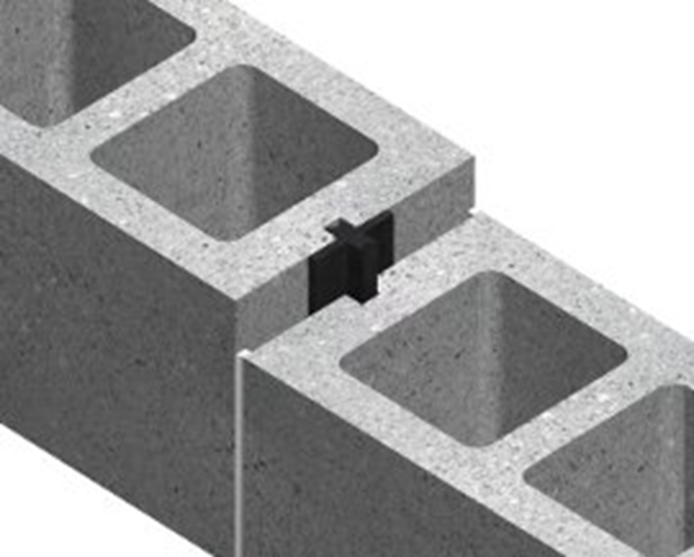
Control Joint Fillers
Replace mortar in expansion or contraction joints in block walls
Break bond between adjacent block and allow expansion and contraction of wall
Notes:
Discuss how joint fillers fill control joints to keep moisture out of spaces.

Slide 25
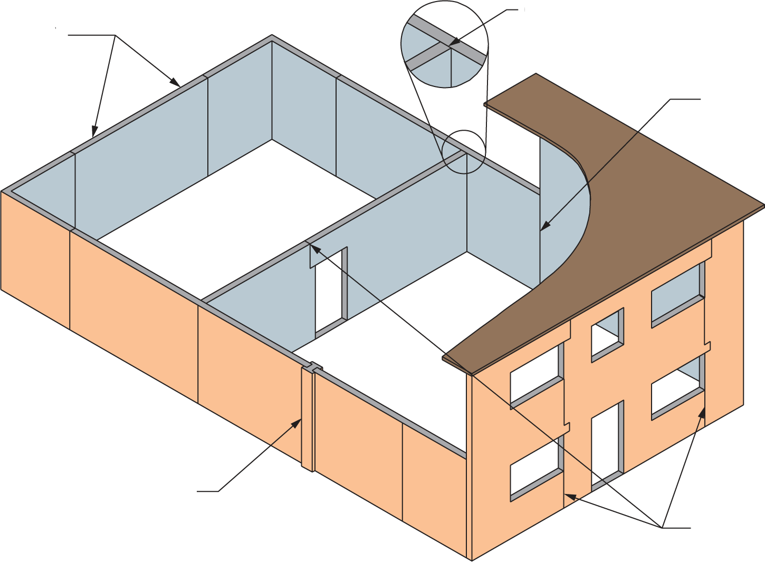
Control Joint Locations
At Maximum of
One-Half Control
Joint Spacing
From Corners
Between Main And
Intersecting Wall
At Changes
In Wall Height
At Pilasters And
Changes In Wall
Thickness
Adjacent To Lintel And
Through Opening If Not
Crossing Vertical
Reinforcement

Slide 26
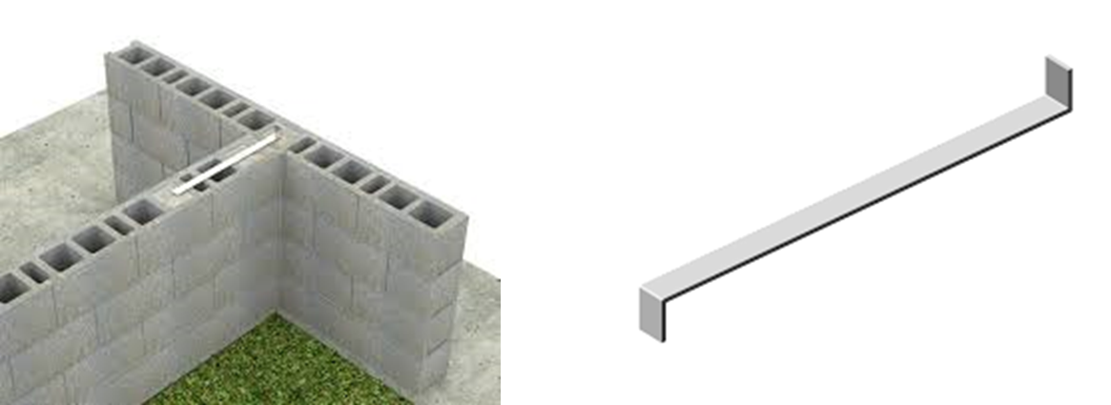
Rigid Wall Anchors
Prevent walls from separating when load is imposed
Notes:
Point out that anchors must be installed according to specifications because they affect the loadbearing of a wall.

Slide 27
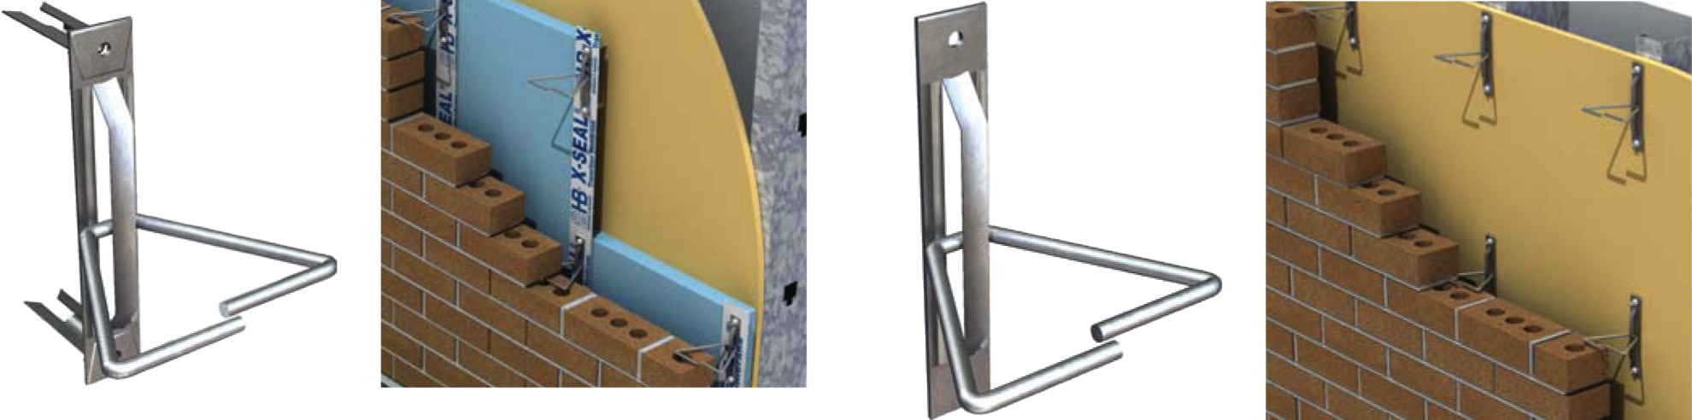
Veneer Ties
Tie brick veneer to steel and wood stud walls
Notes:
Point out that anchors must be installed according to specifications because they affect the loadbearing of a wall.

Slide 28
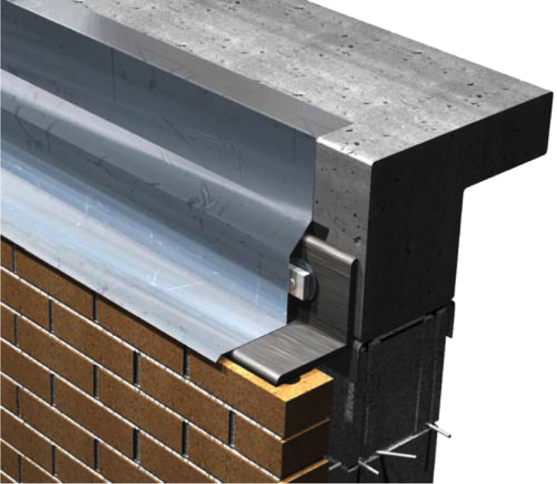
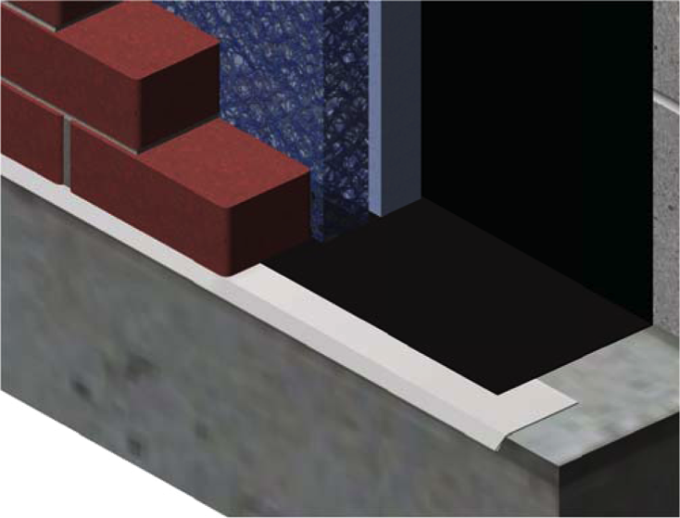
Flashing
Directs moisture away from interior of building
Allows moisture trapped in masonry wall to exit through weep system to outside face of wall
Installed under masonry lintels, sills, copings, and spandrels
Notes:
Discuss the purposes, advantages, and assembly of flashing, as well as the various materials that common flashing is made from.

Slide 29

Questions and Answers

Slide 30
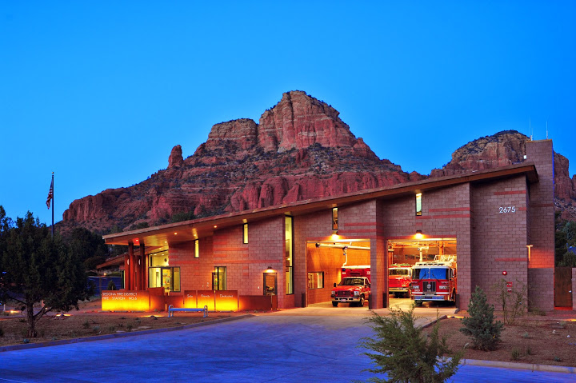

Slide 31


Slide 32

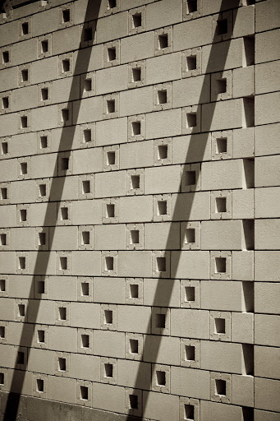
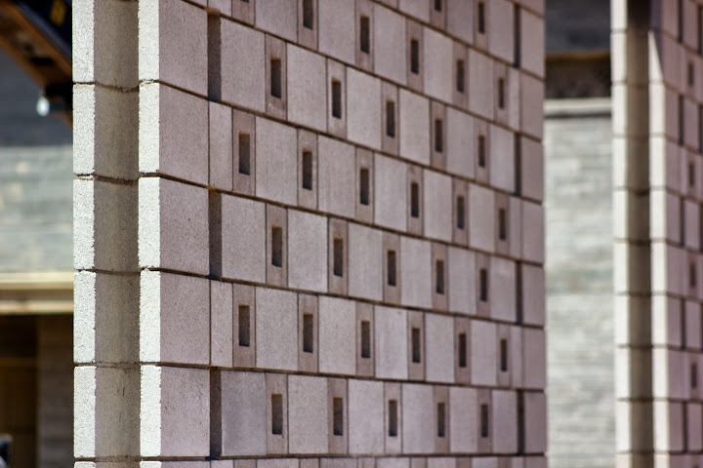

Slide 33
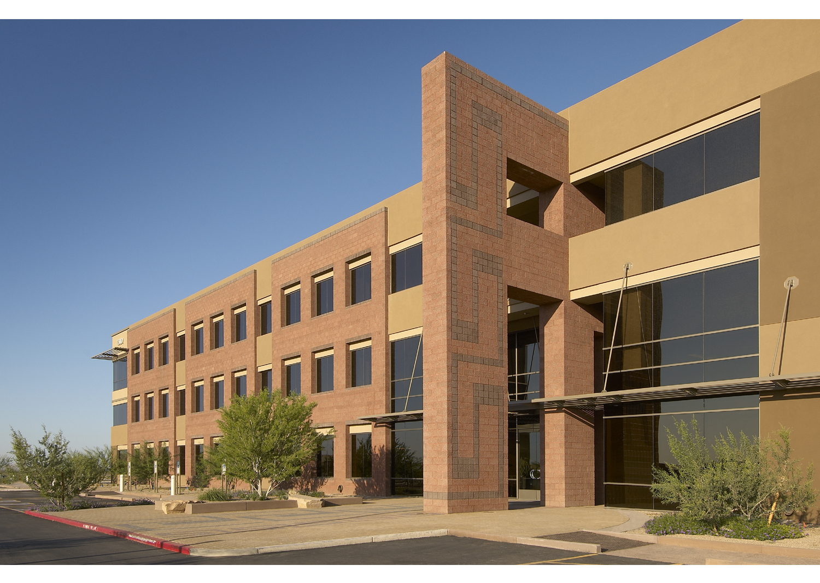

Slide 34


Slide 35


Slide 36


